Slide 1
ONLINE VOTING SYSTEM USING PYTHON
Advanced Programming Practice Mini Project
REVIEW-3
Anitej Mishra (ra2211029010023)
prem LOHIA (ra2211029010007)

Slide 2
TITLE OF THE PROJECT and INTRODUCTION
Every now and then, we must decide on things via voting. What should we do, whom should we invite, who will be the next president of our organization? The scale can range from college sections all the way to nation-wide general elections.
Our objective is to make an Online Voting System using the Python programming language and other platforms to make voting on a topic easy, accessible and simple for everyone. Our system will also enable the organization to easily keep a track on the voting and tabulate the results.

Slide 3
ABSTRACT OF THE MINI PROJECT
This project introduces an innovative Online Voting System designed to simplify and modernize the election process within the scale of college organizations.
Leveraging the capabilities of Python, we've created a user-friendly platform that enhances accessibility, security, and efficiency.
People can easily and securely cast their votes and monitor real-time election results.
The organization can keep a track of the voting and then tabulate and publish the results of the same, in a transparent and accurate way.
This system not only streamlines the entire election procedure but also encourages higher participation, transparency, and accuracy in college elections.

Slide 4
Algorithm used
Voter
organization
Start
Register for voting
Validate identity and authenticate
Create the virtual ballot
Cast the vote
Confirm the vote and display the appropriate message
Stop
Start
Initialize the system
Register the candidates/options
Register the eligible voters and their identities
Implement security measures
Track the voting process
Close the voting once completed
Tabulate and display the results
Stop

Slide 5
GRAPHICAL USER INTERFACE (GUI)
Our project implements a GUI approach to allow the voter to login with their credentials and cast their vote, and the admin to control the server, register the voter and find the results.
The home page is the centre of the GUI, which allows the user to pick between admin and voter, and the respective windows then perform their respective functions as specified above.
The screenshots of the same are shown in the following slides…

Slide 6
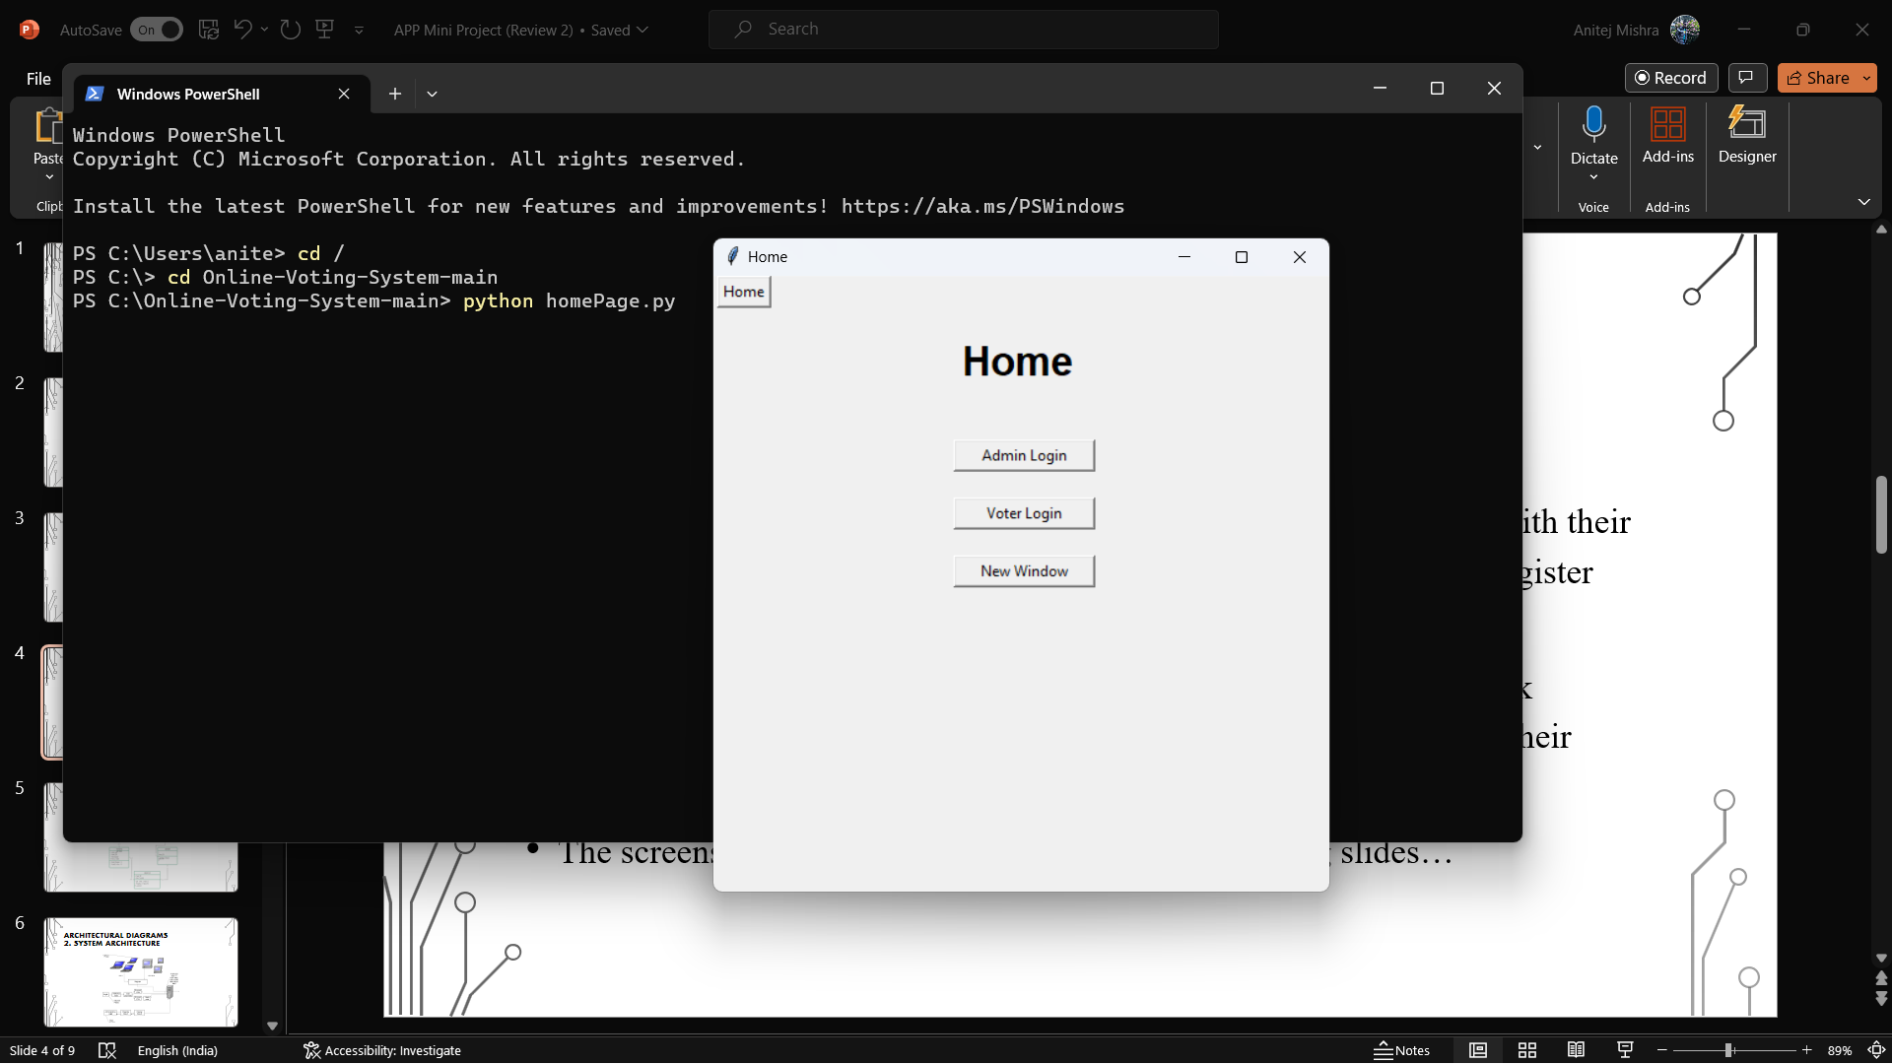
GRAPHICAL USER INTERFACE (GUI)

Slide 7
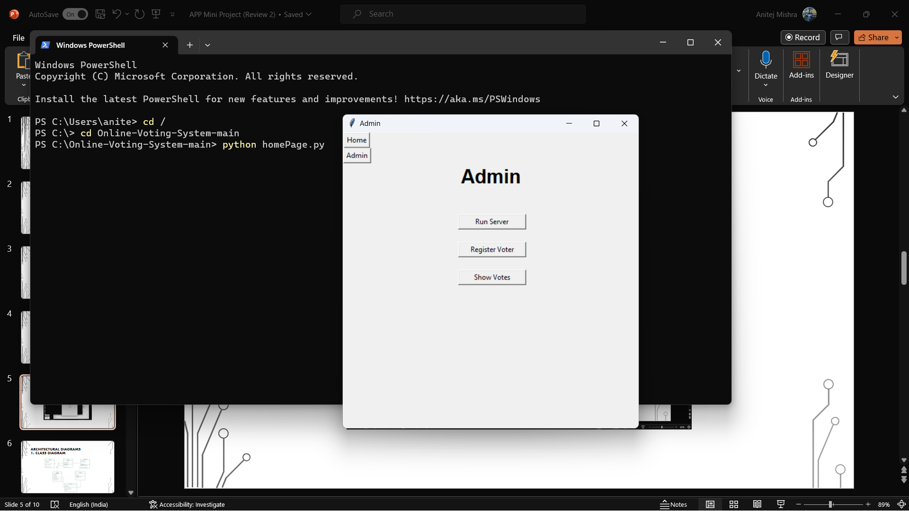
GRAPHICAL USER INTERFACE (GUI)

Slide 8
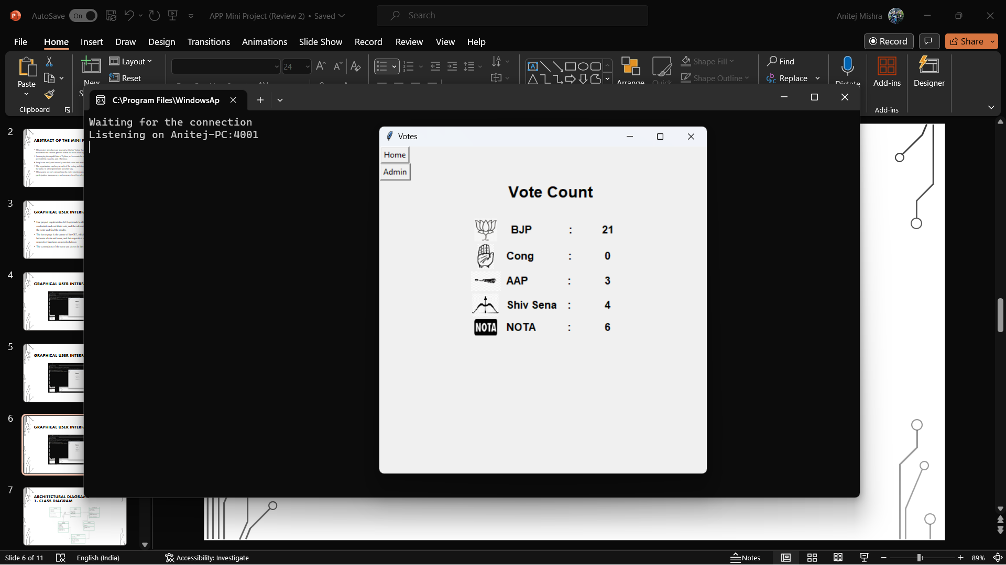
GRAPHICAL USER INTERFACE (GUI)

Slide 9
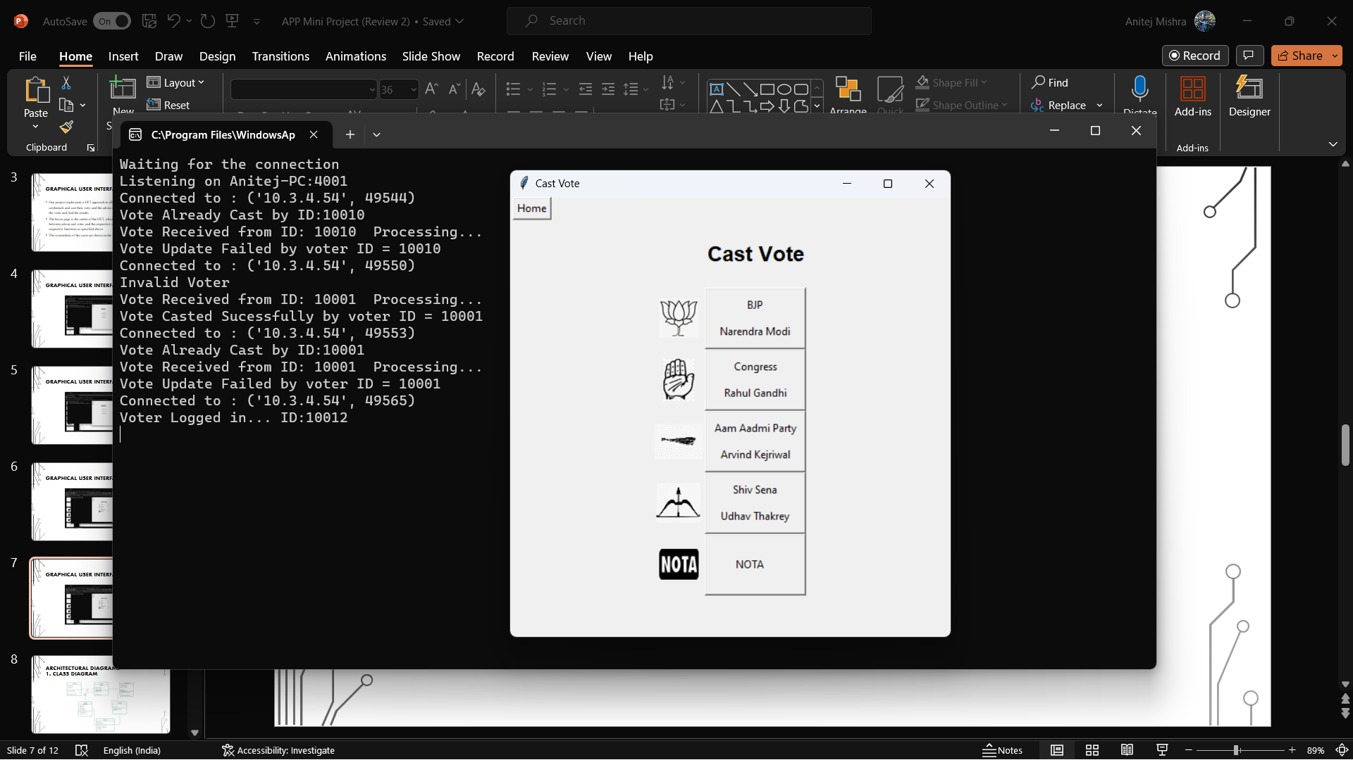
GRAPHICAL USER INTERFACE (GUI)

Slide 10
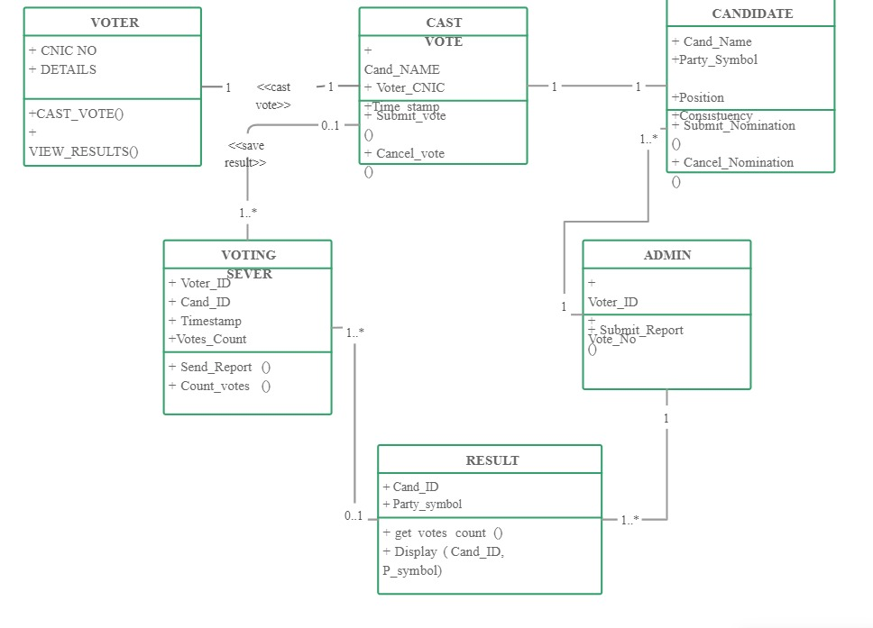
Architectural diagrams 1. CLASS DIAGRAM

Slide 11
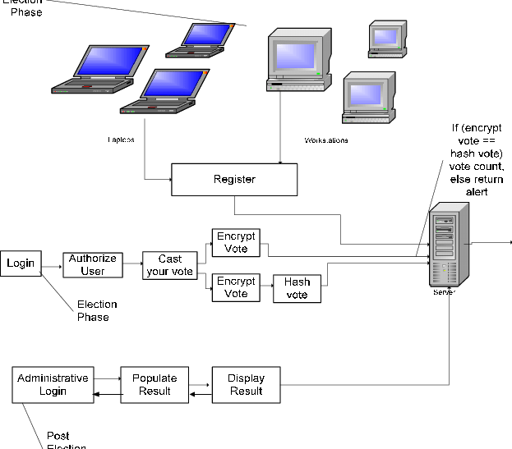
Architectural diagrams 2. SYSTEM ARCHITECTURE

Slide 12
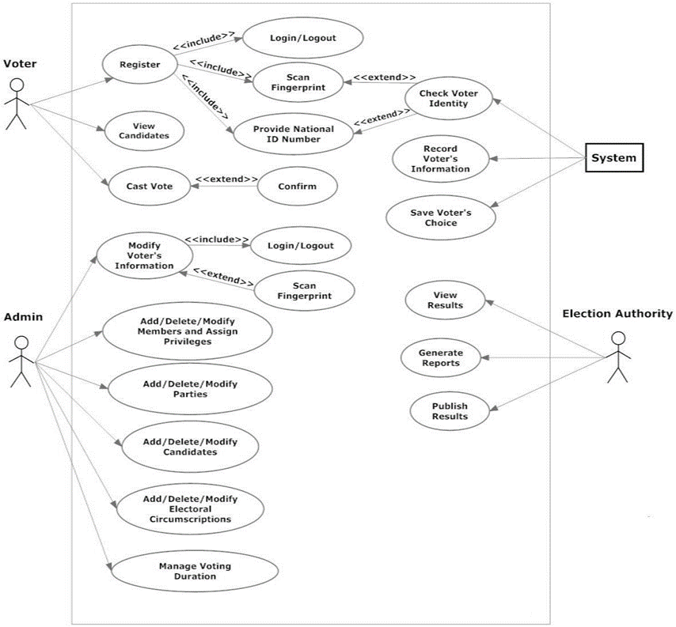
Architectural diagrams 3. USE CASE DIAGRAM

Slide 13
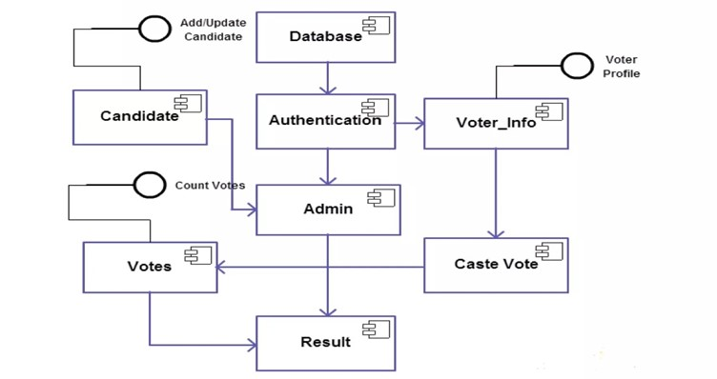
Architectural diagrams 4. COMPONENT DIAGRAM

Slide 14
SAMPLE CODE
import subprocess as sb_p
import tkinter as tk
import registerVoter as regV
import admFunc as adFunc
from tkinter import *
from registerVoter import *
from admFunc import * def AdminHome(root,frame1,frame3):
root.title("Admin")
for widget in frame1.winfo_children():
widget.destroy() Button(frame3, text="Admin", command = lambda: AdminHome(root, frame1, frame3)).grid(row = 1, column = 0)
frame3.pack(side=TOP) Label(frame1, text="Admin", font=('Helvetica', 25, 'bold')).grid(row = 0, column = 1)
Label(frame1, text="").grid(row = 1,column = 0)
The code on the right is for the admin…
Part 1/4

Slide 15
SAMPLE CODE
#Admin Login
runServer = Button(frame1, text="Run Server", width=15, command = lambda: sb_p.call('start python Server.py', shell=True)) #Voter Login
registerVoter = Button(frame1, text="Register Voter", width=15, command = lambda: regV.Register(root, frame1)) #Show Votes
showVotes = Button(frame1, text="Show Votes", width=15, command = lambda: adFunc.showVotes(root, frame1)) #Reset Data
reset = Button(frame1, text="Reset All", width=15, command = lambda: adFunc.resetAll(root, frame1)) Label(frame1, text="").grid(row = 2,column = 0)
Label(frame1, text="").grid(row = 4,column = 0)
Label(frame1, text="").grid(row = 6,column = 0)
Label(frame1, text="").grid(row = 8,column = 0)
runServer.grid(row = 3, column = 1, columnspan = 2)
registerVoter.grid(row = 5, column = 1, columnspan = 2)
showVotes.grid(row = 7, column = 1, columnspan = 2)
# reset.grid(row = 9, column = 1, columnspan = 2)
The code on the right is for the admin…
Part 2/4

Slide 16
SAMPLE CODE
frame1.pack()
root.mainloop() def log_admin(root,frame1,admin_ID,password): if(admin_ID=="Admin" and password=="admin"):
frame3 = root.winfo_children()[1]
AdminHome(root, frame1, frame3)
else:
msg = Message(frame1, text="Either ID or Password is Incorrect", width=500)
msg.grid(row = 6, column = 0, columnspan = 5) def AdmLogin(root,frame1): root.title("Admin Login")
for widget in frame1.winfo_children():
widget.destroy()
The code on the right is for the admin…
Part 3/4

Slide 17
SAMPLE CODE
Label(frame1, text="Admin Login", font=('Helvetica', 18, 'bold')).grid(row = 0, column = 2, rowspan=1)
Label(frame1, text="").grid(row = 1,column = 0)
Label(frame1, text="Admin ID: ", anchor="e", justify=LEFT).grid(row = 2,column = 0)
Label(frame1, text="Password: ", anchor="e", justify=LEFT).grid(row = 3,column = 0) admin_ID = tk.StringVar()
password = tk.StringVar() e1 = Entry(frame1, textvariable = admin_ID)
e1.grid(row = 2,column = 2)
e2 = Entry(frame1, textvariable = password, show = '*')
e2.grid(row = 3,column = 2) sub = Button(frame1, text="Login", width=10, command = lambda: log_admin(root, frame1, admin_ID.get(), password.get()))
Label(frame1, text="").grid(row = 4,column = 0)
sub.grid(row = 5, column = 3, columnspan = 2) frame1.pack()
root.mainloop()
The code on the right is for the admin…
Part 4/4

Slide 18
RESULTS
HOME PAGE
VOTER LOGIN

Slide 19
RESULTS
VOTING PAGE
CONFIRMATION

Slide 20
RESULTS
ADMIN PAGE
VOTING RESULTS

Slide 21
THANK YOU!
Submitted by
Anitej Mishra (ra2211029010023)
Prem lohia (ra2211029010007)

